Slide 1
Transport Layer
Part 2
Notes:
Version History
8.0 (April 2020)
All slides reformatted for 16:9 aspect ratio
All slides updated to 8th edition material
Use of Calibri font, rather that Gill Sans MT
Add LOTS more animation throughout
added new 8th edition material on QUIC, CUBIC, delay-based congestion control
lighter header font

Slide 2
TCP: overview RFCs: 793,1122, 2018, 5681, 7323
point-to-point:
one sender, one receiver
reliable, in-order byte steam:
full duplex data:
MSS: maximum segment size
MSS: maximum amount of
application layer data in the
segment.
cumulative ACKs
pipelining:
TCP congestion and flow control set window size
connection-oriented:
handshaking (exchange of control messages) initializes sender, receiver state before data exchange
Notes:
Typical MSS is 1460 bytes

Slide 3
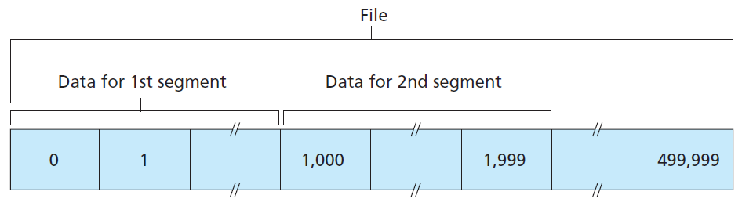
TCP Seq numbers and Acks
Suppose Host A wants to send a stream of data to a process in Host B over a TCP connection. Assume that the data stream consists of a file consisting of 500,000 bytes, and that the MSS is 1,000 bytes. Then the segment looks like this:
Notes:
Typical MSS is 1460 bytes

Slide 4
TCP segment structure
Urgent
32 bits
Request to push
4 bits
source port #
dest port #
ACK: seq # of next expected byte; A bit: this is an ACK
sequence number
acknowledgement number
Length(4 bits) (of TCP header)
head
len
not
used
A
P
S
receive window
flow control
C
E
U
R
F
Internet checksum
checksum
Urg data pointer
options (variable length)
C, E: congestion notification
TCP options
application
data
(variable length)
data sent by application into TCP socket
RST, SYN, FIN: connection management

Slide 5
TCP sequence numbers, ACKs
Sequence numbers:
byte stream “number” of first byte in segment’s data
outgoing segment from sender
source port #
dest port #
sequence number
acknowledgement number
Acknowledgements:
seq # of next byte expected from other side
cumulative ACK
rwnd
checksum
urg pointer
window size
N
sender sequence number space
Q: how the receiver handles out-of-order segments
A: Discards out-of-order segments
B: Keeps the out-of-order bytes in the buffer
sent
ACKed
sent, not-yet ACKed
(“in-flight”)
usable
but not
yet sent
not
usable
outgoing segment from receiver
source port #
dest port #
sequence number
acknowledgement number
A
rwnd
checksum
urg pointer

Slide 6
TCP sequence numbers, ACKs (Some Scenarios)
Host A has received all data from 0 to 535 and Host A is expecting data 536 and all subsequent byte streams from B.
Host A received one segment from 0 through 535 and another segment from 900 to 1000.
It has not received any segment from 536 to 899. Therefore, there has a gap
Cumulative acknowledgments.
Host A received the segment from 900 to 1000 before receiving bytes 536 to 899. Therefore, out of order.

Slide 7

TCP sequence numbers, ACKs
Host A
Host B
User types‘C’
Seq=42, ACK=79, data = ‘C’
host ACKs receipt of‘C’, echoes back ‘C’
Seq=79, ACK=43, data = ‘C’
host ACKs receipt of echoed ‘C’
Seq=43, ACK=80
simple telnet scenario
Notes:
The key thing to note here is that the ACK number (43) on the B-to-A segment is one more than the sequence number (42) on the A-toB segment that triggered that ACK
Similarly, the ACK number (80) on the last A-to-B segment is one more than the sequence number (79) on the B-to-A segment that triggered that ACK

Slide 8
TCP round trip time, timeout
Q: how to set TCP timeout value?
longer than RTT, but RTT varies!
too short: premature timeout, unnecessary retransmissions
too long: slow reaction to segment loss
Q: how to estimate RTT?
SampleRTT:measured time from segment transmission until ACK receipt
ignore retransmissions
SampleRTT will vary, want estimated RTT “smoother”
average several recent measurements, not just current SampleRTT
SampleRTT values will fluctuate from segment to segment due to congestion and load on the end systems.

Slide 9
TCP round trip time, timeout
EstimatedRTT = (1- α)*EstimatedRTT + α*SampleRTT
typical value: α = 0.125
RTT: gaia.cs.umass.edu to fantasia.eurecom.fr
RTT (milliseconds)
sampleRTT
EstimatedRTT
time (seconds)
Notes:
This is how TCP re-computes the estimated RTT each time a new SampleRTT is taken.
The process is knows as an exponeitally weighted moving average, shown by the equation here.
<say it>
Where alpha reflects the influence of the most recent measurements on the estimated RTT; a typical value of alpha used in implementaitons is .125
The graph at the bottom show measured RTTs beween a host in the Massachusetts and a host in France, as well as the estimated, “smoothed” RTT

Slide 10

TCP round trip time, timeout
DevRTT: EWMA of SampleRTT deviation from EstimatedRTT:
DevRTT = (1-β)*DevRTT + β*|SampleRTT-EstimatedRTT|
(typically, β = 0.25)
timeout interval: EstimatedRTT plus “safety margin”
large variation in EstimatedRTT: want a larger safety margin
TimeoutInterval = EstimatedRTT + 4*DevRTT
estimated RTT
“safety margin”
* Check out the online interactive exercises for more examples: http://gaia.cs.umass.edu/kurose_ross/interactive/
Notes:
Given this value of the estimated RTT, TCP computes the timeout interval to be the estimated RTT plus a “safety margin”
And the intuition is that if we are seeing a large variation in SAMPLERTT – the RTT estimates are fluctuating a lot - then we’ll want a larger savety margin
So TCP computes the Timeout interval to be the Estimated RTT plus 4 times a measure of deviation in the RTT.
The deviation in the RTT is computed as the eWMA of the difference between the most recently measured SampleRTT from the Estimated RTT

Slide 11
TCP round trip time, timeout
Consider the TCP procedure for estimating RTT.
Let SampleRTT1 be the most recent sample RTT, let SampleRTT2 be the next most recent sample RTT, and so on.
Assume that SampleRTT2 = 90ms, SampleRTT1 = 75ms.
Compute the EstimatedRT T after each of these SampleRTT values is obtained, using a value of α = 0.125 and assuming that the value of EstimatedRTT was 100ms just before the first of these two samples was obtained.
Compute also the DevRT T after each sample is obtained, assuming a value of β = 0.25 and assuming the value of DevRT T was 20 ms just before the first of two three samples was obtained. Lastly, compute the TCPTimeoutInterval after each of these samples is obtained

Slide 12
TCP: retransmission scenarios
Host A
Host B
Host A
Host B
SendBase=92
Seq=92, 8 bytes of data
Seq=92, 8 bytes of data
timeout
timeout
Seq=100, 20 bytes of data
ACK=100
X
ACK=100
ACK=120
Seq=92, 8 bytes of data
Seq=92, 8
bytes of data
SendBase=100
send cumulative
ACK for 120
SendBase=120
ACK=100
ACK=120
SendBase=120
lost ACK scenario
premature timeout
Notes:
To cement our understanding of TCP reliability, let’s look a a few retransmission scenarios
In the first case a TCP segments is transmited and the ACK is lost, and the TCP timeout mechanism results in another copy of being transmitted and then re-ACKed a the sender
In the second example two segments are sent and acknowledged, but there is a premature timeout e for the first segment, which is retransmitted. Notet that when this retransmitted segment is received, the receiver has already received the first two segments, and so resends a cumulative ACK for both segments received so far, rather than an ACK for just this fist segment.

Slide 13
TCP: retransmission scenarios
Host A
Host B
Seq=92, 8 bytes of data
Seq=100, 20 bytes of data
ACK=100
X
ACK=120
Seq=120, 15 bytes of data
cumulative ACK covers for earlier lost ACK
Notes:
And in this last example, two segments are again transmitted, the first ACK is lost but the second ACK, a cumulative ACK arrives at the sender, which then can transmit a third segment, knowing that the first two have arrived, even though the ACK for the first segment was lost

Slide 14

TCP fast retransmit
Host A
Host B
TCP fast retransmit
if sender receives 3 additional ACKs for same data (“triple duplicate ACKs”), resend unACKed segment with smallest seq #
likely that unACKed segment lost, so don’t wait for timeout
Seq=92, 8 bytes of data
Seq=100, 20 bytes of data
X
ACK=100
timeout
ACK=100
ACK=100
ACK=100
Receipt of three duplicate ACKs indicates 3 segments received after a missing segment – lost segment is likely. So retransmit!
Seq=100, 20 bytes of data
Notes:
Let’s wrap up our study of TCP reliability by discussing an optimization to the original TCP known as TCP fast retransmit,
Take a look at this example on the right where 5 segments are transmitted and the second segment is lost. In this case the TCP receiver sends an ACK 100 acknowledging the first received segment.
When the third segment arrives at the receiver, the TCP receiver sends another ACK 100 since the second segment has not arrived. And similarly for the 4th and 5th segments to arrive.
Now what does the sender see? The sender receives the first ACK 100 it has been hoping for, but then three additional duplicate ACK100s arrive. The sender knows that somethings’ wrong – it knows the first segment arrived at the receiver but three later arriving segments at the receiver – the ones that generated the three duplicate ACKs – we received correctly but were not in order. That is, that there was a missing segment at the receiver when each of the three duplicate ACK were generated.
With fast retransmit, the arrival of three duplicate ACK causes the sender to retransmit its oldest unACKed segment, without waiting for a timeout event. This allows TCP to recover more quickly from what is very likely a loss event
specifically that the second segment has been lost, since three higher -numbered segments were received

Slide 15
TCP 3-way handshake
Server state
Client state
LISTEN
LISTEN
choose init seq num, x
send TCP SYN msg
SYNSENT
SYNbit=1, Seq=x
choose init seq num, y
send TCP SYNACK
msg, acking SYN
SYN RCVD
SYNbit=1, Seq=y
ACKbit=1; ACKnum=x+1
received SYNACK(x)
indicates server is live;
send ACK for SYNACK;
this segment may contain
client-to-server data
ESTAB
ACKbit=1, ACKnum=y+1
received ACK(y)
indicates client is live
ESTAB
Notes:
TCP’s three way handshake, that operates as follows
Let’s say the client and server both create a TCP socket as we learned about in Chapter 2 and enter the LISTEN state
The client then connects to the server sending a SYN message with a sequence number x (SYN Message is an TCP Segment with SYN but set in the header – you might want to go back and review the TCP segment format!)
The server is waiting for a connection, and receives the SYN message enters the SYN received state (NOT the established state and sends a SYN ACK message back.
Finally the client sends an ACK message to the server, and when the server receiver this enters the ESTABLished state. This is when the application process would see the return from the wait on the socket accept() call

Slide 16
Closing a TCP connection
client, server each close their side of connection
send TCP segment with FIN bit = 1
respond to received FIN with ACK
on receiving FIN, ACK can be combined with own FIN
simultaneous FIN exchanges can be handled
Notes:
All good things must come to an end, and that’s true for a TCP connection as well.
And of course there’s a protocol for one side to gracefully close of a TCP connection using a FIN message, to which the other side sends a FINACK message and waits around a bit to respond to any retransmitted FIN messages before timing out.

Slide 17
TCP: closing a connection
client state
server state
ESTAB
ESTAB
FIN_WAIT_1
can no longer
send but can
receive data
FINbit=1, seq=x
CLOSE_WAIT
ACKbit=1; ACKnum=x+1
can still
send data
FIN_WAIT_2
wait for server
close
LAST_ACK
FINbit=1, seq=y
TIMED_WAIT
can no longer
send data
ACKbit=1; ACKnum=y+1
timed wait
for 2*max
segment lifetime
CLOSED
CLOSED

Slide 18
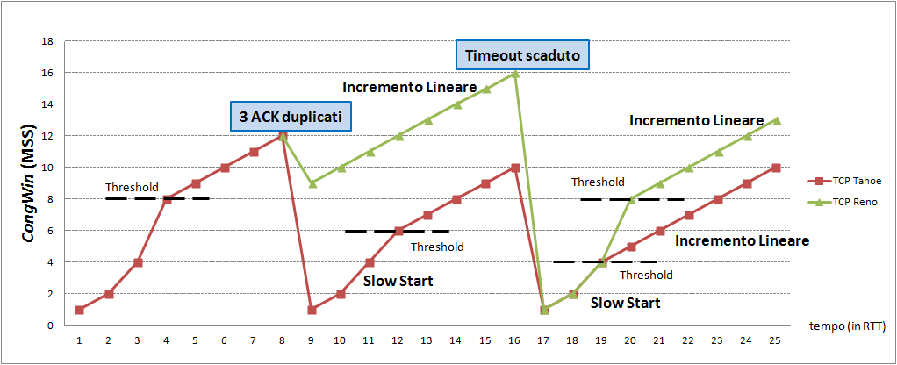
Congestion Control

Slide 19
TCP congestion control: AIMD
approach: senders can increase sending rate until packet loss (congestion) occurs, then decrease sending rate on loss event
Additive Increase
Multiplicative Decrease
increase sending rate by 1 maximum segment size every RTT until loss detected
cut sending rate in half at each loss event
TCP sender Sending rate
time

Slide 20
TCP congestion control: details
sender sequence number space
TCP sending behavior:
roughly: send cwnd bytes, wait RTT for ACKS, then send more bytes
cwnd
last byte
ACKed
sent, but not-yet ACKed
(“in-flight”)
available but not used
~
last byte sent
TCP sender limits transmission:
cwnd is dynamically adjusted in response to observed network congestion (implementing TCP congestion control)
<
cwnd
LastByteSent- LastByteAcked

Slide 21
TCP Slow Start
Host A
Host B
when connection begins, increase rate exponentially until first loss event:
initially cwnd = 1 MSS
double cwnd every RTT
done by incrementing cwnd for every ACK received
one segment
RTT
two segments
four segments
summary: initial rate is slow, but ramps up exponentially fast
time

Slide 22
TCP Slow Start
loss indicated by timeout:
cwnd set to 1 MSS;
window then grows exponentially (as in slow start) to threshold, then grows linearly
Set the threshold value ssthresh is equal to cwnd/2
When the value of cwnd >= ssthresh, Slow Start ends and Congestion Avoidance (CA) starts.
loss indicated by 3 duplicate ACKs: TCP enters in the fast recovery mode.

Slide 23
TCP: Congestion Avoidance (CA)
Rather than doubling the cwnd value, cwnd is increased by just a single MSS every RTT.
When the congestion avoidance ends?
Depends on the timeout events and triple duplicates
dup ACKs indicate network capable of delivering some segments
Fast Recovery: 3 dup ACKs
TCP Tahoe always sets cwnd to 1 then grows exponentially (timeout or 3 duplicate acks) [Earlier Style]
TCP Reno cut the cwnd in half window then grows linearly [New Version]

Slide 24
Summary: TCP congestion control
When CongWin is below Threshold, sender in slow start
phase, window grows exponentially.
When CongWin is above Threshold, sender is in congestion
avoidance phase, window grows linearly.
When a triple duplicate ACK occurs, Threshold set to
CongWin/2 and CongWin set to Threshold + 3.
When timeout occurs, Threshold set to CongWin/2 and
CongWin is set to 1 MSS.

